Slide 1

Second Interviewer
Interviewers

Slide 2
Fieldwork Flow – Second Interviewer
Arrive in cluster, Identify households
Interviewers carry out module interviews, collect height/weight
Supervisor assigns households
Interviewers send data to supervisor
Interview HHs, identify eligible individuals
Team resolves structural problems
Interviewer A assigns modules to Interviewer B
Supervisor submits data to central office
Notes:
Quick look at the flow of field work from start to finish in a cluster – training will refer back to this chart regularly

Slide 3




Finalize Modules 1 and 2
Assign Interviewer B for the household
Assign modules to Interviewer B
Send data to Interviewer B, begin work

Slide 4
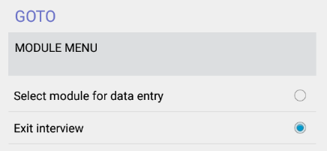
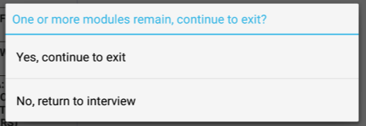
Finalize Modules 1 and 2
Mod 1
Module 2 starts right away
Mod 2
Finalize, then continue or exit
EXIT
Exit to assign Interv. B
Notes:
Module 2 must be completed before beginning remaining modules because eligibility for Module 7.1 – 7.3 is contained in Module 2.
Can “select module for data entry” if interviewer wishes to continue, but for 2nd interviewer assignment, first exit interview.

Slide 5
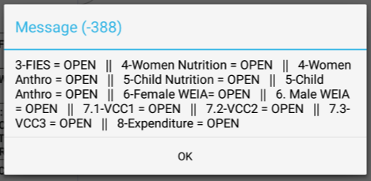
Finalize Modules 1 and 2
Before exiting, status of applicable modules will appear:
Notes:
All modules that apply (based on responses to Module 1 and 2) will show, either with OPEN or DONE

Slide 6
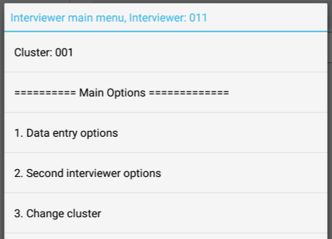
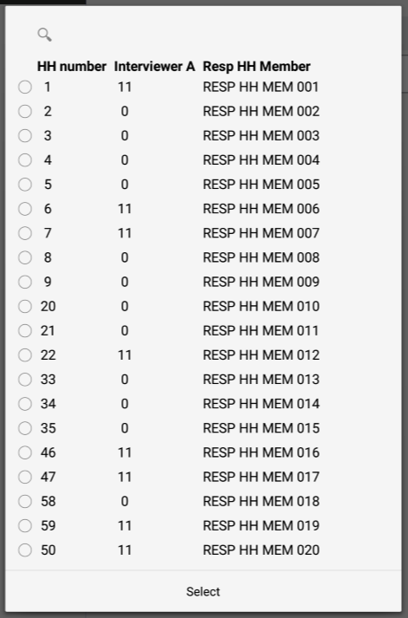
Assign Interviewer B
All households appear
Select the household to which you are assigning a second interviewer
Notes:
If interviewers need to change the interviewer B assignment, follow the same steps – there will be an extra message asking if you would like to choose a new Interviewer B or keep current assignment.
Note that all households appear for selection because the system has not been told if the interviewer is A or B, so all options need to be available.

Slide 7
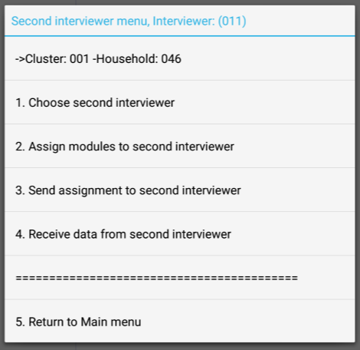
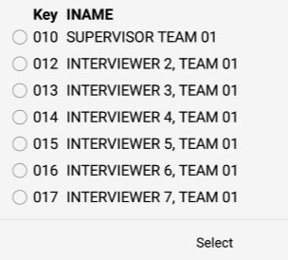
Assign Interviewer B
Cluster and household are shown – double check!
Notes:
Choose the name of the interviewer you want to choose to be Interviewer B for your household!
Double check you have selected the household properly…

Slide 8
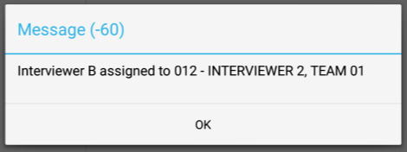

Assign Interviewer B
Assigning Interviewer B must be done before assigning any modules

Slide 9
Assign modules to Interviewer B
Choose the household to assign modules
Notes:
Same steps initially before – choose 2. Second interviewer options, and then choose the household

Slide 10
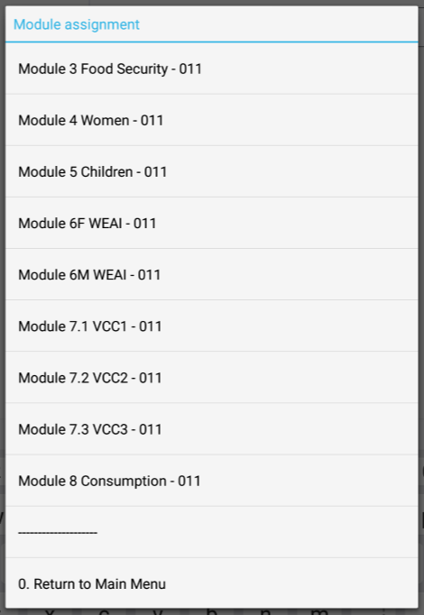
Assign modules to Interviewer B
All applicable modules for the household appear
Interviewer assignment:
Default is interviewer assigned to household by supervisor
Notes:
Notice that all modules are currently assigned to primary interviewer – default is to keep the household assignment for all modules. Changes when a second interviewer is assigned to a module (or more than one).

Slide 11
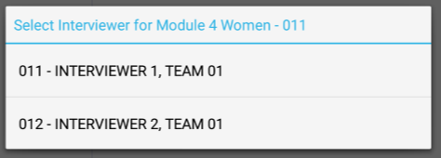

Assign modules to Interviewer B
Choose the module
Choose the interviewer
Notes:
Only the household owner (Interviewer A) and the assigned second interviewer (Interviewer B) will appear in the list. If the interviewer meant to give the module to someone else, they would need to reassign Interviewer B (step 2).
Once assigned, the module assignment list will show an updated assignement.

Slide 12
Send assignment to Interviewer B
Both interviewers choose household with modules being assigned
Notes:
Both interviewer A and B should choose option 2, then the household where modules were assigned

Slide 13
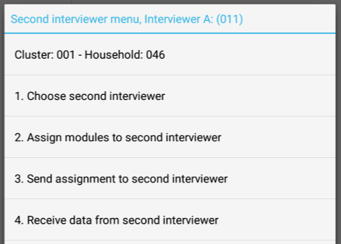
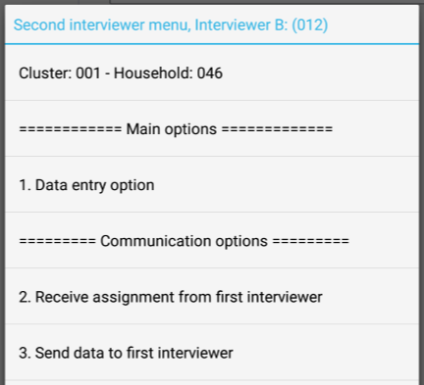
Send assignment to Interviewer B
Interviewer A – choose option 3:
Interviewer B – choose option 2:
Notes:
Interviewers A and B see different menus… based on the household chosen and the household assignment file.

Slide 14
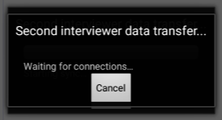

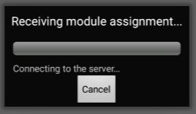
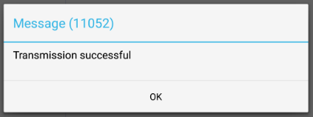
Send assignment to Interviewer B
Notes:
Interviewers A and B see different menus… based on the household chosen and the household assignment file.

Slide 15
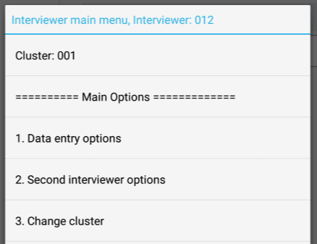
Interviewer B begins work
From interviewer main menu, choose option 2:
From second interviewer menu, choose option 1:
Notes:
Interviewers A and B see different menus… based on the household chosen and the household assignment file.

Slide 16
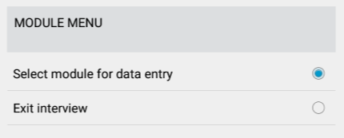
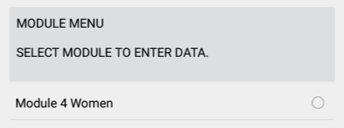

Interviewer B begins work
Immediately sent to Module Menu
Only modules assigned to Interviewer B appear
Select module and start interviewing!

Slide 17

Practice time!
Find a teammate to share work with
Assign each other two modules per completed household (Modules 1 & 2)
Assign Interviewer B
Assign modules to Interviewer B
Send data to Interviewer B
Begin working!
Notes:
Either practice interviews, OR if available, paper questionnaires can be used to fill in CAPI (checking for errors in CAPI)

